Slide 1

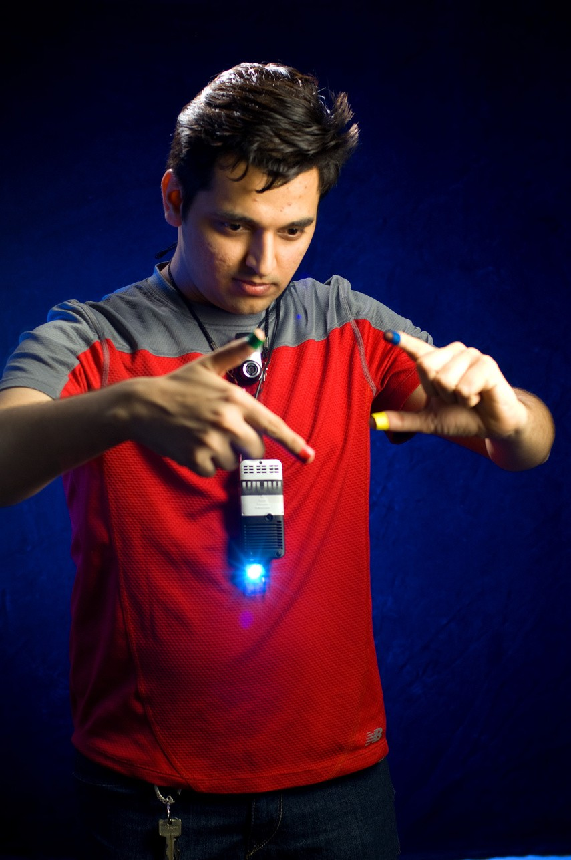
SIXTH SENSE TECHNOLOGY - NEW REALITY

Slide 2

CONTENT
1
INTRODUCTION
5 WORKING
2
HISTORY
6
APPLICATIONS
WHY CHOOSE SIXTH SENSE ?
3
7
CONCLUSION
4
COMPONENTS

Slide 3



INTRODUCTION
We humans, interact with the world using our five senses.
But as the name suggests this technology brings forward an additional sixth sense.
A sixth sense is an ESP(Extra Sensory Perception) that aims at a more developed future.
Both the physical and digital world can be connected without the help of hardware devices.

Slide 4
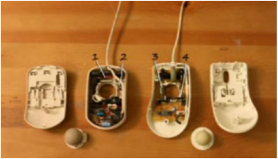
HISTORY
Steve Mann, often regarded as the pioneer of Sixth Sense technology
The initial implementation of Sixth Sense Technology involved a neck-worn projector and camera system.
Subsequently, an Indian innovator named Pranav Mistry, further developed and popularized this technology

Slide 5
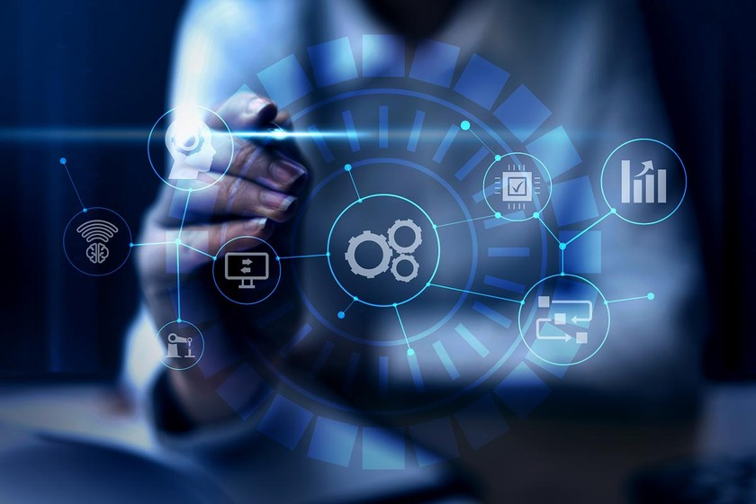
WHY CHOOSE SIXTH SENSE ?
Sixth Sense technology offers the advantage of interfacing with the digital world through intuitive hand gestures.
Its applications extend significantly into the realm of artificial intelligence.

Slide 6
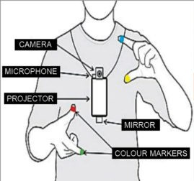

COMPONENTS
T H E
Camera Projector Mirror
Mobile components Colored Markers
P O W E R
O F
S I X T H
S E N S E

Slide 7
CAMERA
The camera is the key input device of the Sixth Sense system.
The camera acts as a digital eye of the system.
It basically captures the scene the user is looking at.
PROJECTOR
The projector is the key output device of the Sixth Sense system.
The mobile computing device provides the projector with the content to be projected

Slide 8
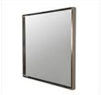
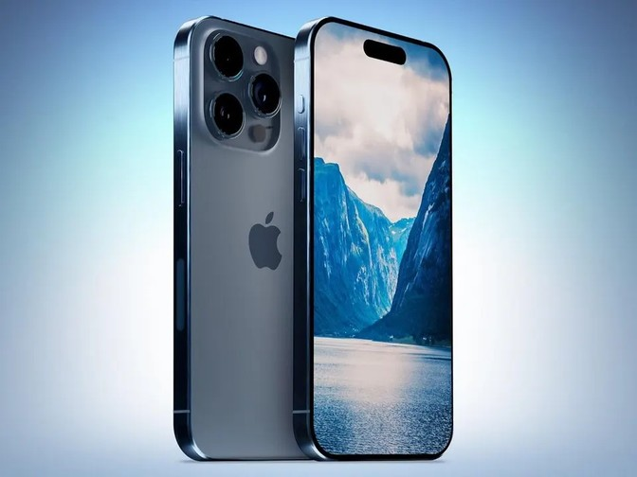
MIRROR
The mirror reflects the projection coming out from the projector
The user manually can change the tilt of the mirror to change the location of the projection.
SMARTPHONE
A web enabled smart phone. It processes the video data.

Slide 9

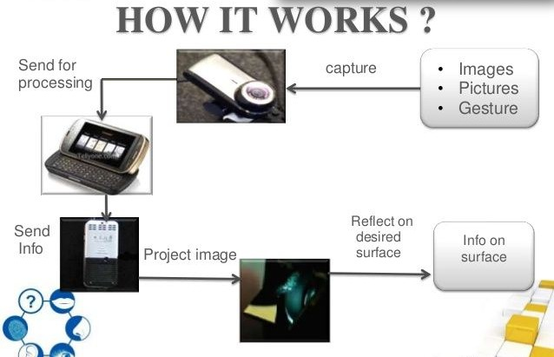
WORKING

Slide 10
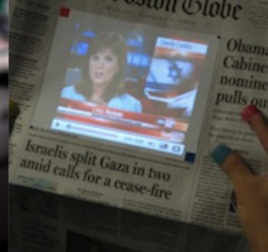
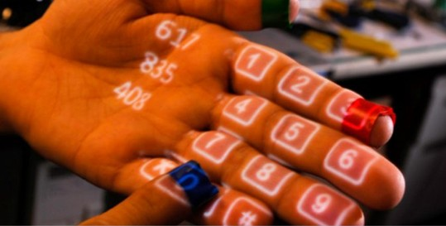
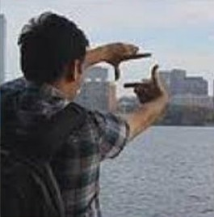
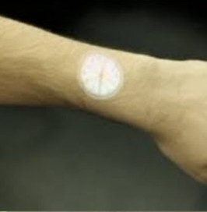
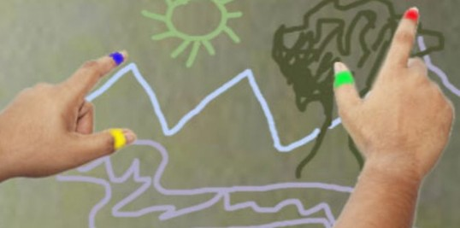
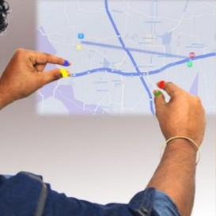
APPLICATIONS
Multimedia Reading Exp
Make a Phone Calll
Take Pictures
Check The Time
Drawing Applications
Call up a Map

Slide 11
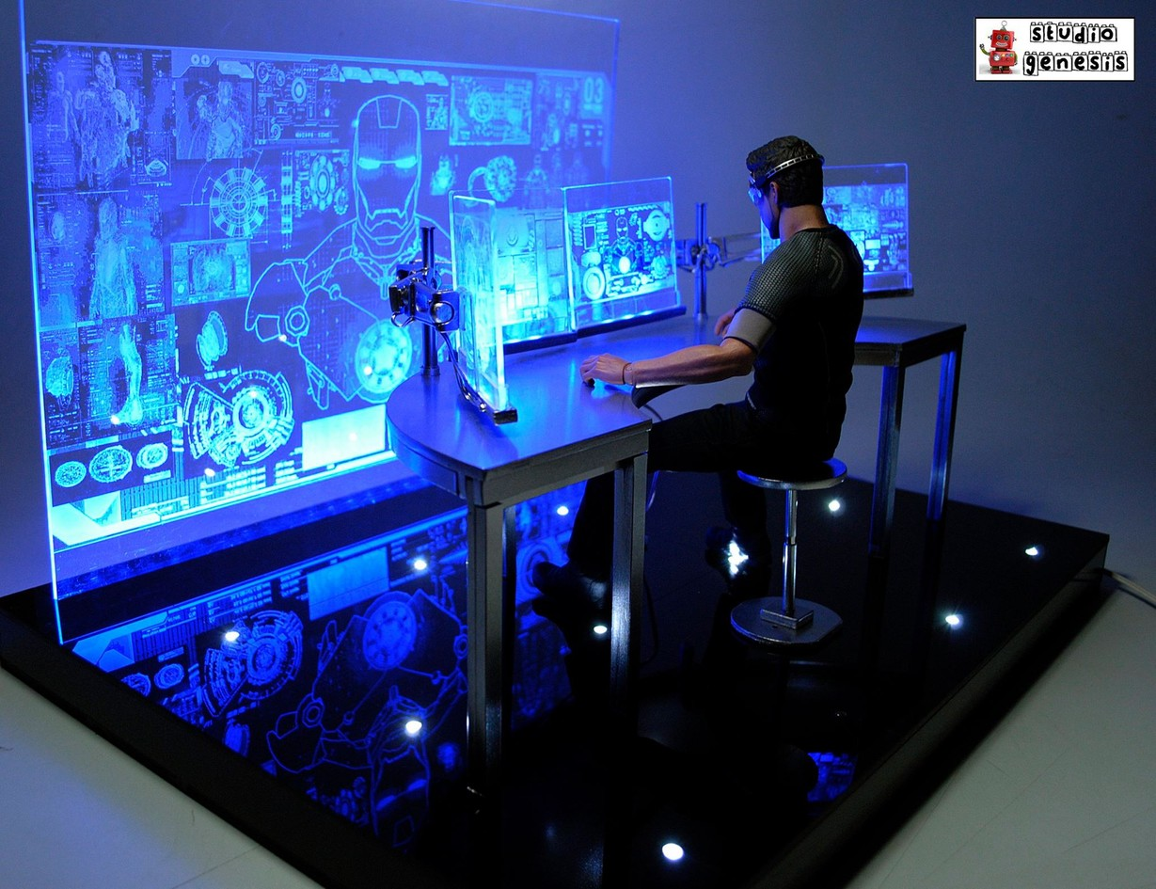
CONCLUSION
Recognizes the Objects
Displaying information automatically
Access it in any way we need
Can demonstrate the Usefulness, Viability And Flexibility of the system
Interact with the information via Natural Hand Gestures.

